Slide 1
Business Services
Marcia Hultman
Cabinet Secretary

Slide 2
South Dakota Economic Snapshot
March 2019
Labor Force 464,200
Employment 451,000
Unemployment 13,200
Unemployment Rate 2.8%
Notes:
South Dakota, March 2019, seasonally adjusted
Tied for fifth lowest with Hawaii and Nebraska at 2.8%
(1) North Dakota and Vermont – 2.3%
(3) Iowa and New Hampshire – 2.4%

Slide 3
You’ll also be interested to know…
Jobs Available = 15,722
Candidates = 3,961
Candidates per Job Opening = 0.3
Notes:
Real-time Demand/Supply Indicators Available from the Virtual Labor Market Data System
As of May 3, 2019
Definitions
Job Openings - All jobs advertised online in South Dakota on a single day
Candidates - Individuals with active résumés in the workforce system on a single day
Candidates Per Job Opening - Percentage of candidates to job openings on a single day

Slide 4
Working Together
DLR’s Role
Help employers maintain a skilled workforce through training and education
Your Role
Use our services to help your business and strengthen your workforce

Slide 5
On-the-Job Training
Provides participants knowledge and skills essential to the job
Employers can be reimbursed up to 50% of the wage rate
DLR provides monitoring to ensure success
Visit with your Job Service office about possibilities.
Notes:
An OJT is designed to provide job participants knowledge and skills essential to the performance of a job. This can include the introduction of new technology, production or service procedures, upgrading to new jobs that require additional skills and workplace literacy.
OJT is provided under contract with an employer or registered apprenticeship program sponsor in the public, private non-profit or private sector. Employers can be reimbursed up to 50 percent of the wage rate for an OJT participant to help cover the costs of training and supervision. The reimbursement is limited in duration as appropriate to the occupation that the participant is being trained.
OJT contracts may be entered into with registered apprenticeship sponsors or participating employers in registered apprenticeship programs for the OJT portion of the registered apprenticeship program. Depending on the length of the registered apprenticeship and OJT policies, these funds may cover some of the costs of the registered apprenticeship training.
The employer, participant and employment specialist work closely together to ensure the participant is well matched to the training. Monitoring is conducted throughout the training period to ensure that the OJT is successful.

Slide 6
Work Experiences
Job shadowing
Informational interviews
Classroom presentations
Worksite tours
Express interest @ CareerLaunchSD.com
Notes:
Partner with DLR to allow individuals to explore what a day is like in your shoes. A job shadow or informational interview allows an individual to determine if your field is the right match for them.
During the job shadow or informational interview, individuals can learn more about the business, ask questions and expand their network. Familiarity with the job can reduce turnover. While the individual is learning, you are also learning more about the possibility of their fit in your organization.

Slide 7
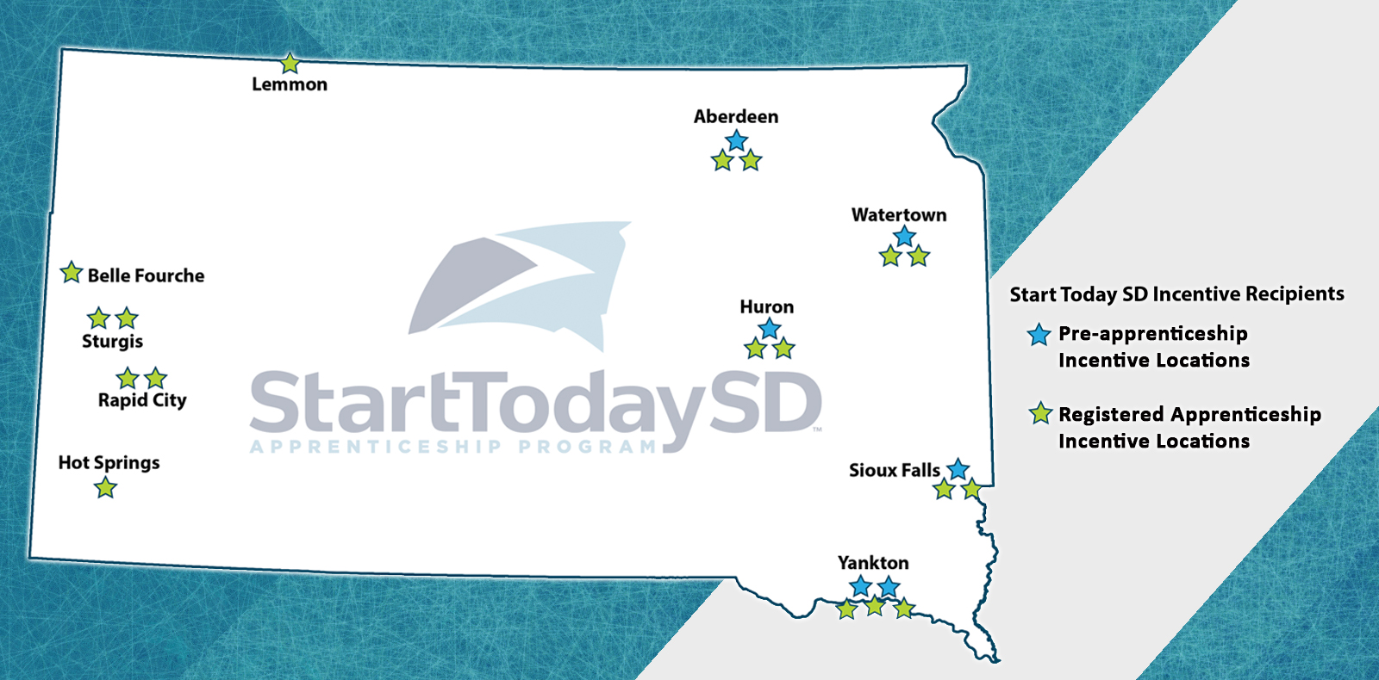
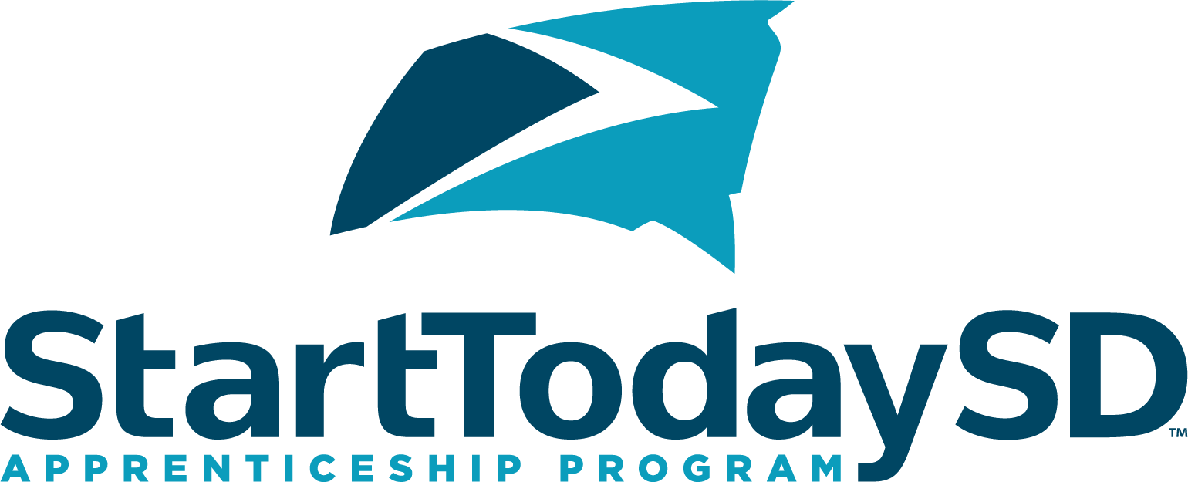
Registered Apprenticeships
Structured learning + OJT with mentor
Build a quality workforce with the right skills
Increase retention, gain committed employees
Visit StartTodaySD.com
or Email StartToday@state.sd.us
Notes:
The U.S. Dept. of Labor, Office of Apprenticeship has signed the standards for 17 new programs. Upon completion of a Registered Apprenticeship program, the apprentice receives an industry-issued, nationally recognized credential certifying occupational proficiency.
“A Registered Apprenticeship provides a unique combination of structured learning with on-the-job training from an assigned mentor,” said state Labor and Regulation Secretary Marcia Hultman. “Apprenticeships are a great way for businesses to build a quality workforce with the exact skills they need.”
Despite myths apprenticeships are only in the trades occupations, opportunities are available in thousands of industries – from construction and commercial trades to healthcare and service industries. Nationally, there is a network of over 150,000 employers in more than 1,000 occupations.
“It’s great to see a variety of programs come together so quickly that will provide South Dakotans new opportunities,” said Secretary Hultman. “These employers have stepped up to provide their own innovative solutions to their workforce needs.”
Industry associations, higher-education institutions, organizations and other workforce intermediaries can be Registered Apprenticeship sponsors. A business can be a sponsor and manage all aspects the program, or partner with an established sponsor. For every dollar spent on apprenticeships, employers receive approximately $1.47 return on investment.
Organizations and occupations approved include: • Aberdeen Fire & Rescue, paramedic • Applied Engineering, machinist • Bear Butte Gardens, diversified organic vegetable farm manager • Dynamic Engineering, machinist • Howe Inc., HVAC • Huron Regional Medical Center, LPN • Independent Health Solutions, home health aide • Lake Area Technical Institute, welder • LemmonMade, Inc., all around butcher • LIV Hospitality, lodge manager • Midstates Group, web press operator • Paramedics Plus, paramedic • Regional Technical Education Center, industrial maintenance technician • Scott Peterson Motors, master certified automotive technician • Select Construction, carpenter • Sturgis Brewing Company, professional brewer • Yankton EMS, paramedic

Slide 8
National Career Readiness Certificate
Measures skills necessary for workplace success
Benefits:
Hiring
Training and Promotion
Retention
Recognize, recommend, and prefer the NCRC
Notes:
The National Career Readiness Certificate (NCRC™) is an industry-recognized, portable, evidence-based credential that certifies essential skills necessary for workplace success.
Learn how your business can use the NCRC in screening, hiring, promoting and training.
South Dakota employers who would like to join the effort in recognizing, recommending or preferring the NCRC as a way to ensure the hiring of a certified and skilled workforce should complete the NCRC Recognition Form (Adobe PDF format). By completing, signing and submitting the signed Recognition Form, you will grant us permission to use your name in public awareness efforts to promote the National Career Readiness Certificate. For example, your business or agency will be added to the list below of South Dakota employers supporting the NCRC.

Slide 9
Soft Skills Training
Bring Your ‘A’ Game to Work
Attendance, Appearance, Attitude, Ambition, Accountability, Acceptance, and Appreciation
Offered at no cost to businesses and individuals
Register online at sdjobs.org >> Learn About Programs >> BYAG

Slide 10
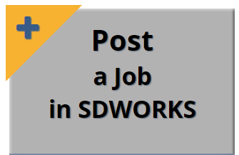
SDWORKS
Define skills and post job orders using common language
Research LMI and economic data
Set up a Virtual Recruiter
Communicate within the system email and message center
Create account at sdjobs.org >> Post a Job

Slide 11
Labor Market Information
Occupational wage estimates
Worker levels and pay by industry and size of business
Employment and demand projections by industry and occupation
Employee benefits
Visit sdjobs.org >>
Labor Market Information
Notes:
Virtual LMI system >> real time data
Ways businesses can tap into the power
Employee Recruitment
Reducing Turnover and Keeping Workers
Setting Compensation Levels
Relocating to or Expanding in a New Area
Downsizing or Closing
Knowing Where to Market Products
General Labor Economics Awareness
Employee Recruitment
Labor supply estimates
Labor force data (the employed and unemployed)
Number of workers by occupation
Occupational wage data
Candidate data
Relocating to or Expanding in a New Area
Candidate data
Labor supply data
Labor force data – employed and unemployed by place of residence
Occupational wage data – number of people in the same or similar occupations and what they earn
Local Employment Dynamics (LED) – shows commuting patterns to identify recruitment area

Slide 12
Dakota Roots
Job advisors connect out-of-state job seekers to South Dakota jobs
Additional labor pool helps hard-to-fill positions
Visit DakotaRoots.com
Notes:
Where have registrations came from?
Participants have registered from all 50 states, Washington, D.C. and Puerto Rico! And from these countries: American Samoa, Australia, Canada, England, Germany, Guam, Holland, Japan, Korea, N. Marina Islands, Portugal, United Kingdom, Virgin Islands
Average age = 37
Majority have come from surrounding states: North Dakota, Minnesota, Nebraska, Iowa, Wyoming, Montana
Top Occupations Entered
Accounting
Customer Service
Education
Healthcare
Production Laborer
Food Service
A wide variety of jobs have been filled, from wait staff, customer services reps, and welders to computer software engineers, registered nurses, and mechanical engineers.
Currently 227 active job seekers. Have placed over 4,800 since inception in 2006.

Slide 13
Questions?

