Slide 1
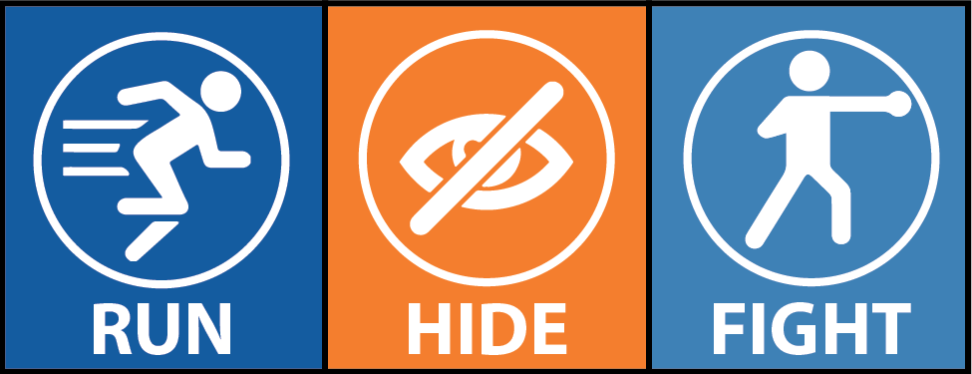
Aberdeen Area Human Resource Association Presents Active Shooter Training – ALICE Model Presented by: Sergeant Keith Theroux, Aberdeen Police Department Best Western Ramkota Hotel, Aberdeen SD Thursday, April 20th , 2017 11:00am-1:00pm
A - Alert
L – Lock Down
I - Inform
C - Counter
E - Evacuate
The threat of an active shooter attack is rare but very real. This training session will aim to eradicate the “It can’t happen to me” mentality and change the way people everywhere respond to armed intruders. THE alice model educates that individuals should be prepared for active shooter events and empowered to make their own life-saving decisions. Sergeant Keith theroux will train on the ALICE Model and build on the run, hide, fight concept which encourages more counter measure in a threat solution.
This free event is open to the public. Please rsvp via the aahra website or by email.
RSVP website: http://aahra.shrm.org/forms/rsvp-APRIL-2017-meeting
RSVP EMAIL: Sheila.Sutton@avera.org
Keith Theroux is currently a patrol Sergeant with the Aberdeen Police Department. He has been with the department close to 15 years serving the community in many functions. Keith has completed training obtaining certifications as a Crime Prevention Specialist and has been practicing Security Assessments since 2005. One of his many missions is to provide assistance to the community by evaluating building design and organizations policies dealing with threats of violence. Once evaluations are completed, suggestions are provided for additions or improvements. The services are offered and conducted for area businesses, schools, homes, and churches. Keith has spent his Law Enforcement Career building partnerships to address fear of crime by empowering people with education helping them in safety and crime prevention measures.
This has been certified for 1 PDC through SHRM and pending 1 HRCI credit.

