Slide 1
When the Hammer Falls: Big Mistakes and Big Verdicts
Cynthia Bremer
Minneapolis Office

Slide 2
Outline
Whopping verdicts
Types of Claims
Jury Statistics
Top Concerns for HR Professionals
Lucky 7 Top Tips to Avoid/Defend Suits

Slide 3
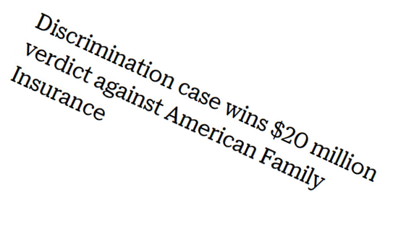
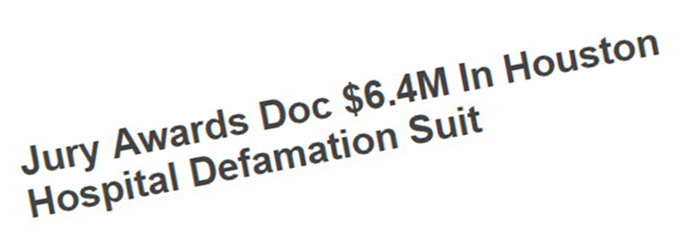
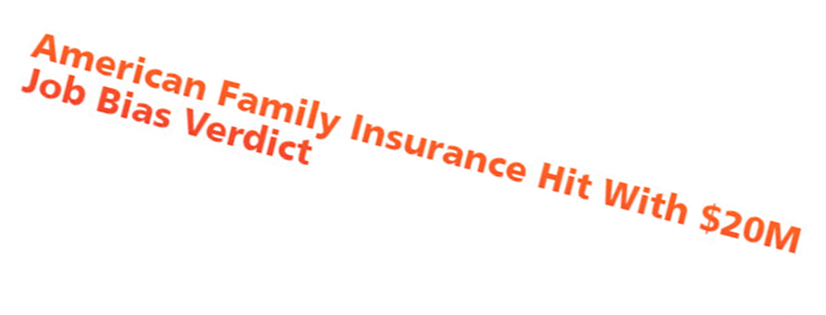
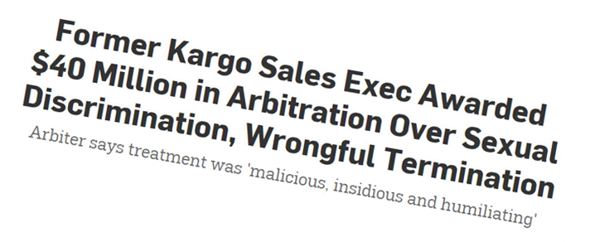

Slide 4
What types of claims?
Age discrimination – damages can be high
Disability discrimination – difficult facts
Sex discrimination/harassment – #MeToo impact
Wage and hour – single or class-wide claim
Retaliation/whistleblowing – human nature?

Slide 5
What happened?
Case #1
Case #2
Case #3

Slide 6
What was the jury thinking?

Slide 7
The Realities of Juries
Lay people not lawyers
Not experienced
Not trained
Care about facts over law
Care about fairness over law
Care about justice over law

Slide 8
Employee rights are well-protected in our society.

Slide 9
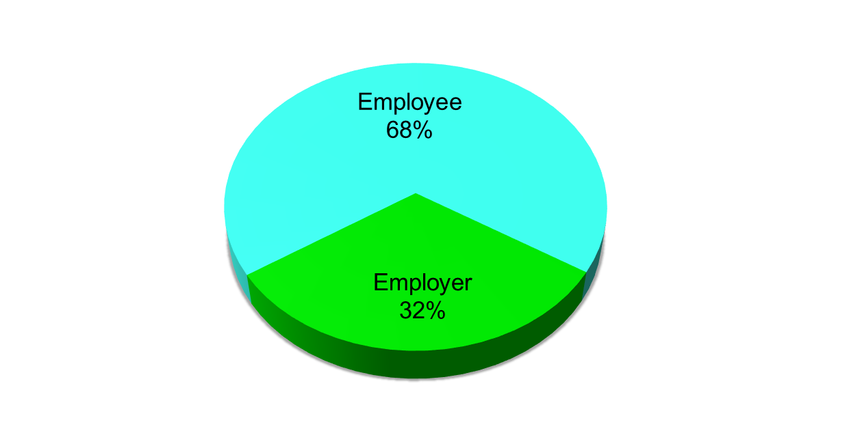
In a dispute between an employee and employer, who would you believe?

Slide 10
An important function of juries in America is to send messages to corporations to improve their behavior.

Slide 11
Are performance reviews usually fair or unfair to the employee being reviewed?

Slide 12
Jury Profile
Defense
Military
Educated – Critical Thinking
Sales
Never Been Laid Off
Never felt unfairly treated in the workplace
Unsure if the case has merit it is has not settled before trial
Union
Uneducated
Psychiatrist, Nurses, social workers, teachers
Having sued someone
Been Laid off
Suffered injury because of treatment at work

Slide 13
Jury Profile
Defense
Plaintiff
Business Owner
Not important for juries to send messages
Do not agree/neutral that corporations put profits ahead of employees
Supervisor (be careful)
Under 50
Status quo
Over 50
Function of jury is to send message
Companies/executives lie for profit
Rents Home
Financial Condition getting worse
Not happy with lot in life

Slide 14
Isn’t that the lawyer’s problem?
Yes and no
Impacts and involves HR and upper management
Drains human and economic resources
Risks impacting company’s reputation among workforce and in community at large

Slide 15
Top Concerns of HR Professionals
Unwitting involvement in bad terminations that led to dispute and a witness in the case
Failure to advise leadership of potential exposure at early stage of dispute
Failure to take opportunity to resolve dispute early, even pre-suit
Huge, surprise, adverse decision at end

Slide 16
“Lucky 7” Top Tips to Avoid/Defend Suits
Document, document, document
We did everything we could…
Avoid differential treatment for same or similar underlying conduct
Consider severance agreements for non-conduct terminations
Maintain robust anti-discrimination policies/procedures and reporting mechanisms
Train employees and supervisors on policies
Investigate issues and solve problems early

Slide 17
Questions

Slide 18
Cynthia A. Bremer
Shareholder
225 S. 6th Street
1800 Capella Tower Minneapolis, MN 55402
612-336-6868
cynthia.bremer@Ogletree.com

